Slide 1
Generalization in Neural Network
Notes:
Choose right model complexity according too data

Slide 2
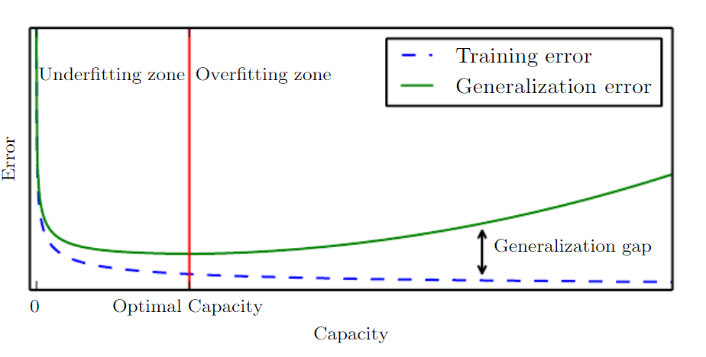
Understanding Generalization In DNN
Generalization
The ability to perform well on previously unobserved inputs/samples.
Notes:
i.i.d assumption -> independent and identically distributed

Slide 3
Understanding Generalization In DNN
Training Error : Error on training data
Test Error : Error on test data
Generalization error = | training_error – test_error |

Slide 4
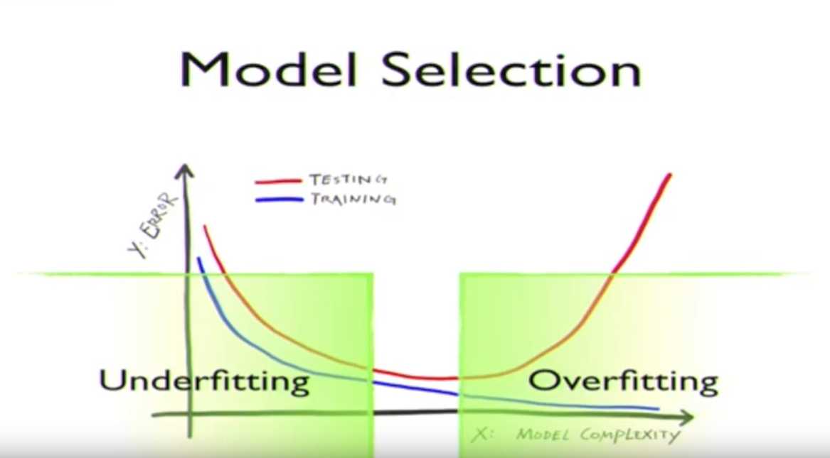

Slide 5
VC Theory …

Slide 6
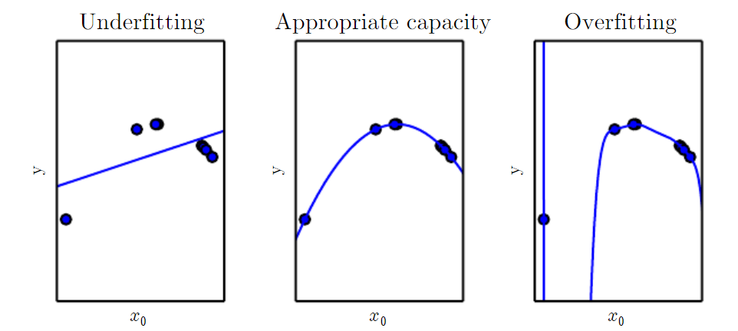
Model Capacity
Notes:
The traditional view of generalization holds that a model
with sufficient capacity (e.g. more parameters than training
examples) will be able to “memorize” each example, overfitting
the training set and yielding poor generalization to
validation and test sets (Goodfellow et al., 2016). Yet deep
neural networks (DNNs) often achieve excellent generalization
performance with massively over-parameterized
models. This phenomenon is not well-understood.

Slide 7
Regularization Technique

Slide 8
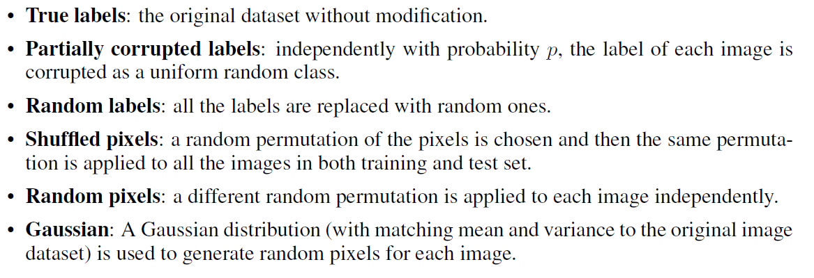
Randomization Test

Slide 9
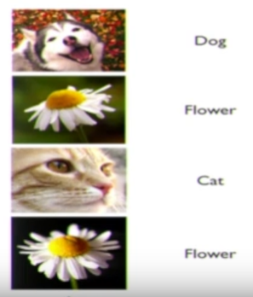

Randomization Test
Randomized Labels

Slide 10
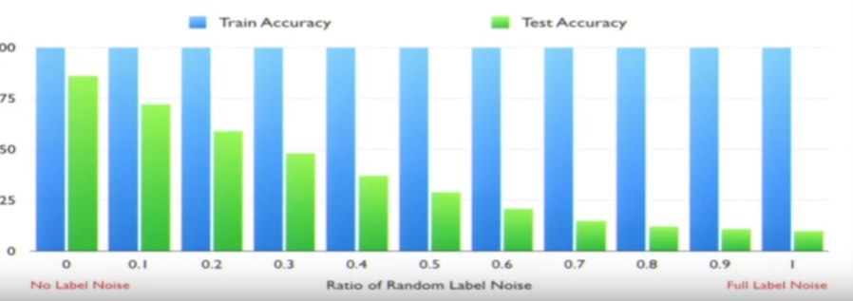

Slide 11
A Closer Look at Memorization in Deep Networks
Notes:
The traditional view of generalization holds that a model
with sufficient capacity (e.g. more parameters than training
examples) will be able to “memorize” each example, overfitting
the training set and yielding poor generalization to
validation and test sets (Goodfellow et al., 2016). Yet deep
neural networks (DNNs) often achieve excellent generalization
performance with massively over-parameterized
models. This phenomenon is not well-understood.

Slide 12
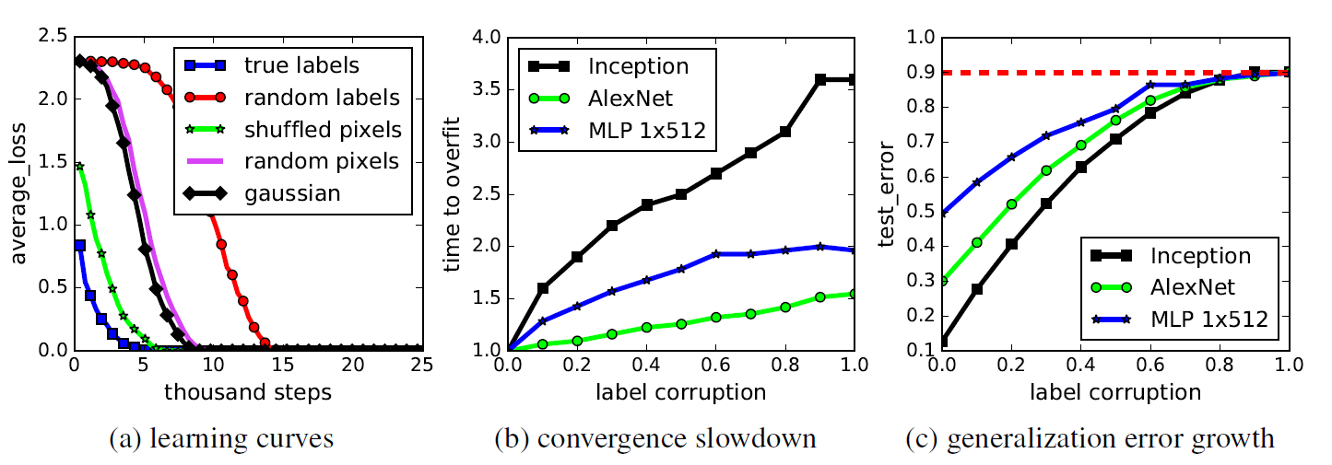

Slide 13
Points to be taken
Neural Network are very good at memorizing random data.
DNN learns simple pattern first, before memorizing, or optimization is content aware.
Regularization makes it harder for the network to memorize.
Notes:
1. There are qualitative differences in DNN optimization
behavior on real data vs. noise. In other words, DNNs
do not just memorize real data (Section 3).
2. DNNs learn simple patterns first, before memorizing
(Section 4). In other words, DNN optimization is
content-aware, taking advantage of patterns shared by
multiple training examples.
3. Regularization techniques can differentially hinder
memorization in DNNs while preserving their ability
to learn about real data (Section 5).

Slide 14


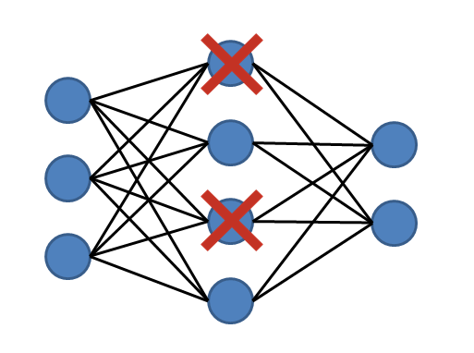
Regularization technique
L1 / L2 Penalty on Weights
Dropout
Early Stopping
Data Augmentation
Implicit Regularization
Batch Normalization
Dropout
Notes:
If DNN are good at memorizing the data,
why DNN Generalize on unseen test data?
We explicitly apply regularization ->
dropout , L2 Norm
But without regularization also NN works well on test data
Initially learn simple features, then complex features
Content aware
Mutual Information –
Hidden layer activation contains about X and Y
Information Pass
First phase of fast fitting : Layer tries to memorize the input
Second – discard some information about input X -> ignore irrelevant part of input information
Forget Different background, noise, lighting, brightness condition -> Forgetting phase
First phase happens very fast
Second phase is very slow - > SNR
Overfitting / Over Compression
Tibshy

